Slide 1
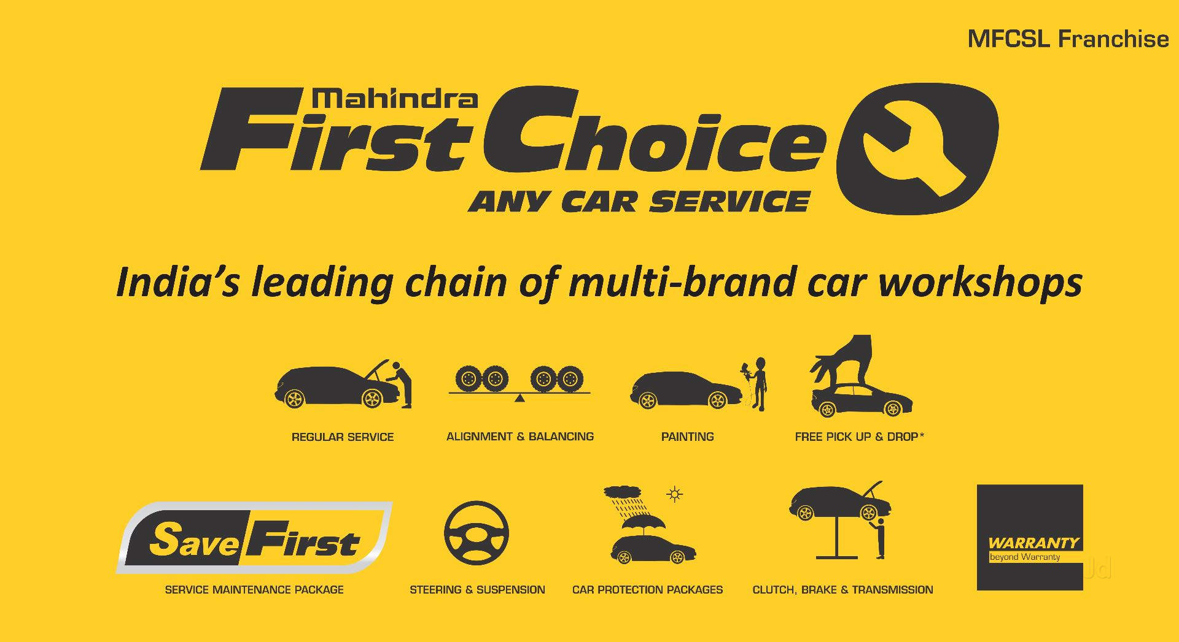
- Weekend Warriors

Slide 2
Team members
Purnima Chandanshive
Elton Landers
Anuj Nadiyana
Pushkar Jamadagni
Niket Patil

Slide 3
Problem statement
Understand ownership and spending patterns of customers throughout the country to boost targeted marketing for attracting customers
Get information on how MFC needs to be prepared to tackle various order types received seasonally
Customer lifetime value prediction.

Slide 4
Why solve this problem?
Understand the market requirements in different regions to take strategic decisions for business expansion
Solving this problem would help MFC with the data required for resource planning and inventory management
Improve the service quality by avoiding delays of delivery in service due to resources unavailability which would increase customer satisfaction

Slide 5
Steps involved in solving the problem
Cleaning and wrangling the data
EDA
Merging the different datasets in to one
Running clustering models
Calculating the LTV of customers
Running classification and regression models on the final dataframe

Slide 6
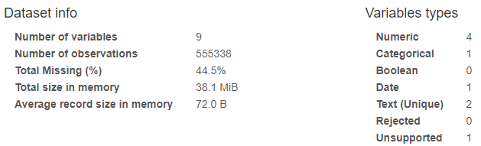
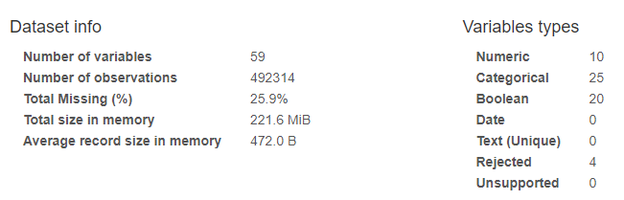
The data we have
Customer data :
Final invoice :

Slide 7
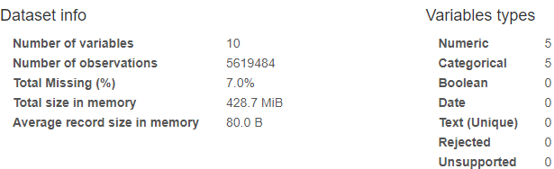
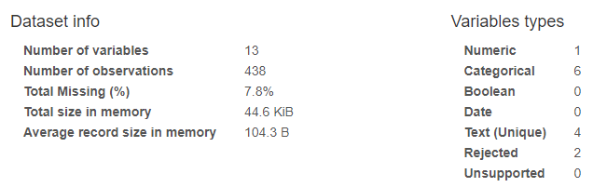
JTD :
Plant master :

Slide 8
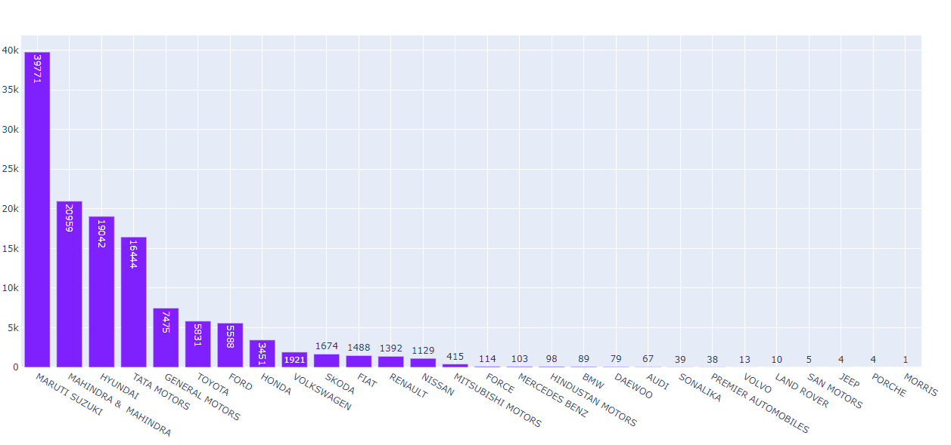
EDA-Univariate
Popular car models

Slide 9
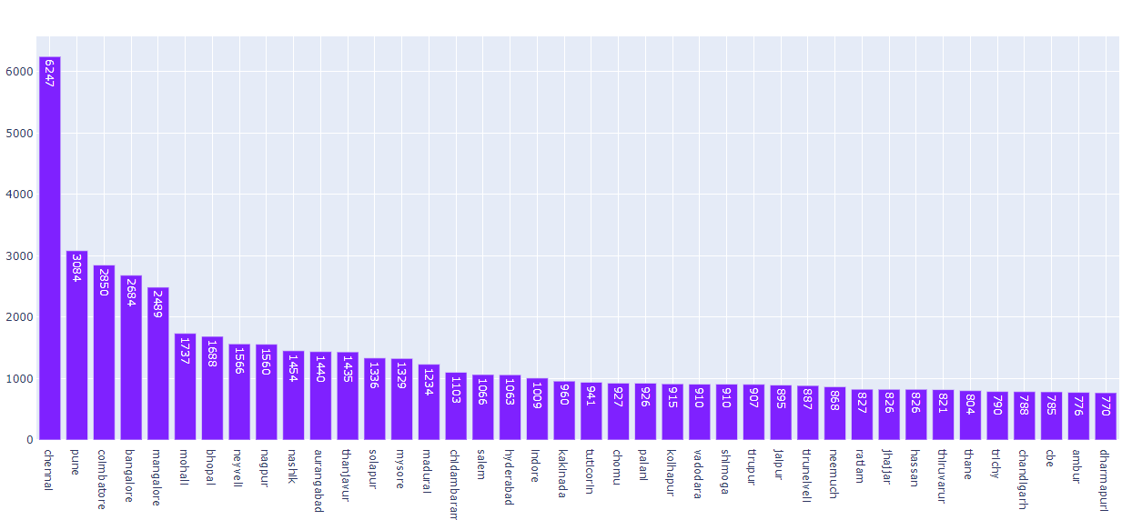
Popular cities

Slide 10
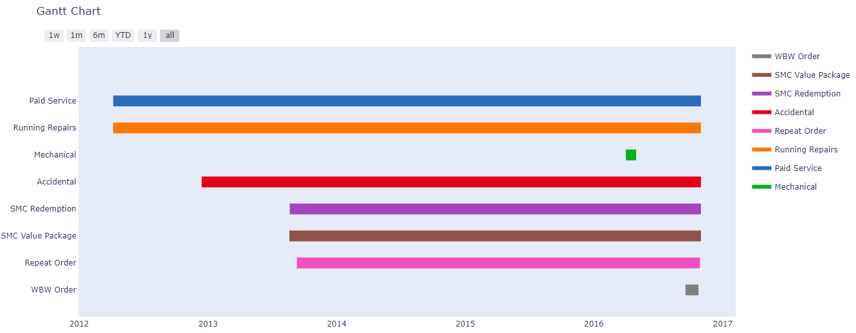
EDA Bivariate
Order type by invoice dates

Slide 11
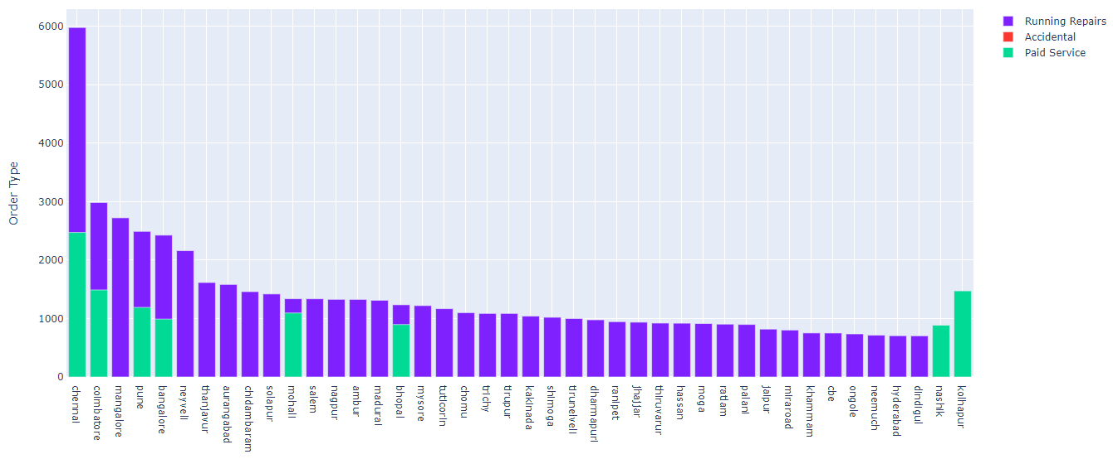
Order type w.r.t. city

Slide 12
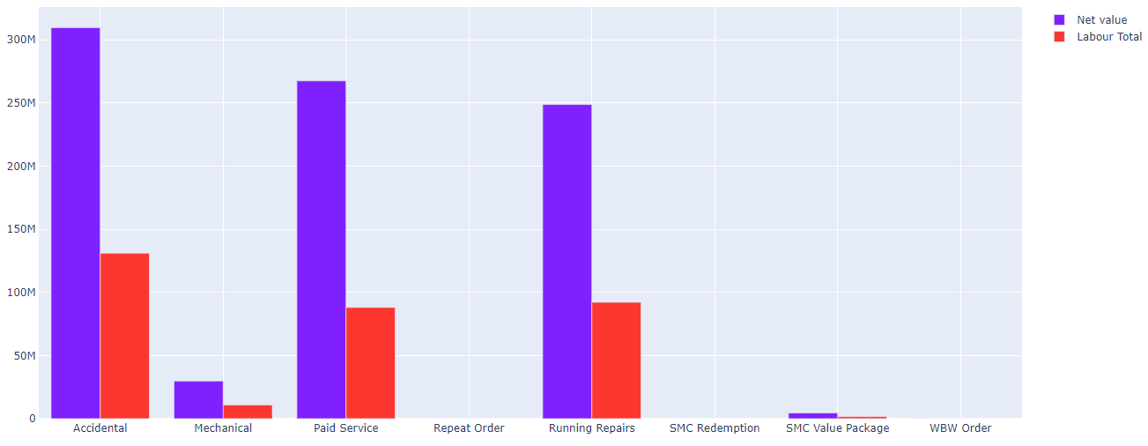
Order type w.r.t net-labour total

Slide 13
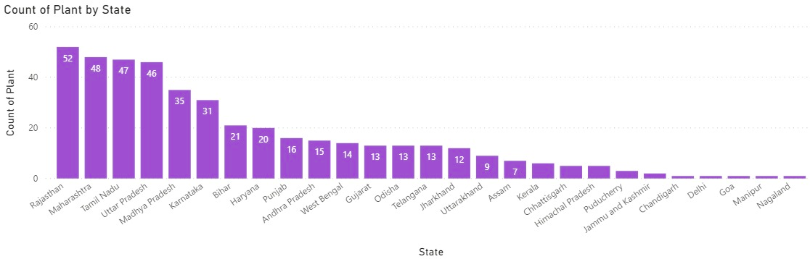
Plant by state

Slide 14
Models and approaches
For clustering purposes we have used K-means clustering model
For classification purposes , we have used a number of models-
Naïve Bayes Classifier
Decision Tree Classifier
Random Forest Classifier
SVM Classifier
Kernel SVM Classifier
KNN Classifier

Slide 15
Evaluation and results
For regression purposes, the following models were utilized-
Decision Tree Regressor
Support Vector Regressor
Multivariate Regression
Random Forest Regressor

Slide 16
Final outcome
The classification models have been evaluated based on their accuracy score
The outcome of classification models are listed below
KKN - 0.78
Naïve Bayes – 0.84
Logistic Regression – 0.98
SVM – 0.98
Random Forest – 0.99
Random Forest outperforms other models

Slide 17
The regression models have been evaluated based on their R-squared score
The outcome of regression models have been listed below-
Decision Tree Regressor – 0.87
Ridge Regressor – 0.76
Lasso Regressor – 0.77
The outcomes of clustering models were-
Segmentation based on partner type- retail, corporate, fleet etc
Segmentation based on order type – the amount spent by the customer
Segmentation based on the basis of service time – The time customer spends on getting the repair done

Slide 18
Value delivered to business
Orders received for Maruti Suzuki are the highest so stocking up more parts for its models would help in faster delivery of service
Aiming for a higher number of workshops in the states of Maharashtra, Tamil Nadu and Karnataka can be optimal as the rate of orders of received in these states are the highest as compared to Rajasthan where the number of platns are highest
People in metro cities tend to carry out paid services more as compared to other cities located near highways where accidental repairs are carried out more often
Thus it is necessary to emphasize more on targeted marketing to provide more value added packages to customers from metro cities
As for other location more parts can be stocked up that are used frequently during accidental repairs

Slide 19
Additional points
The computing resources used were various scientific packages and different machine learning models
The final outcome can be deployed on the Heroku platform by first creating a Flask app
Once the model is deployed, it can be easily available through the web API

Slide 20
Thank you!

